Slide 1
Recommender System

Slide 2
Introduction
Recommender systems are software tools and algorithms designed to suggest relevant items or content to users based on their preferences, behavior, and interactions with a platform.
A recommendation system is a subset of machine learning that uses data to help users find products and content.
Websites and streaming services use recommender systems to generate “for you” or “you might also like” pages and content.
Recommender systems are an essential feature in our digital world, as users are often overwhelmed by choice and need help finding what they're looking for.
This leads to happier customers and, of course, more sales.
Recommender systems are like salesmen who know, based on your history and preferences, what you like.

Slide 3
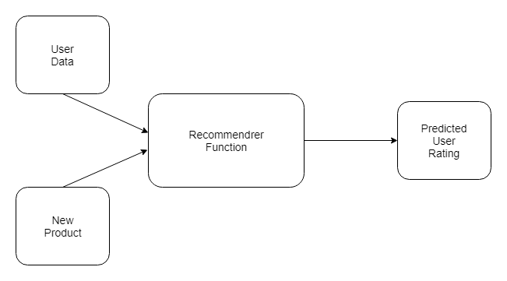
Recommender systems are so commonplace now that many of us use them without even knowing it.
Because we can't possibly look through all the products or content on a website, a recommendation system plays an important role in helping us have a better user experience, while also exposing us to more inventory we might not discover otherwise.
Some examples of recommender systems in action include product recommendations on Amazon, Netflix suggestions for movies and TV shows in your feed, recommended videos on YouTube, music on Spotify, the Facebook newsfeed and Google Ads.

Slide 4
An important component of any of these systems is the recommender function, which takes information about the user and predicts the rating that user might assign to a product, for example.
Predicting user ratings, even before the user has actually provided one, makes recommender systems a powerful tool.

Slide 5
How Do Recommender Systems Work?
UNDERSTANDING RELATIONSHIPS
Relationships provide recommender systems with tremendous insight, as well as an understanding of customers. There are three main types that occur:
User-Product Relationship
The user-product relationship occurs when some users have an affinity or preference towards specific products that they need. For example, a cricket player might have a preference for cricket-related items, thus the e-commerce website will build a user-product relation of player->cricket.
Product-Product Relationship
Product-product relationships occur when items are similar in nature, either by appearance or description. Some examples include books or music of the same genre, dishes from the same cuisine, or news articles from a particular event.
User-User Relationship
User-user relationships occur when some customers have similar taste with respect to a particular product or service. Examples include mutual friends, similar backgrounds, similar age, etc.

Slide 6
DATA & RECOMMENDER SYSTEMS
User Behavior Data
Users behavior data is useful information about the engagement of the user on the product. It can be collected from ratings, clicks and purchase history.
User Demographic Data
User demographic information is related to the user’s personal information such as age, education, income and location.
Product Attribute Data
Product attribute data is information related to the product itself such as genre in case of books, cast in case of movies, cuisine in case of food.

Slide 7
HOW DO WE PROVIDE DATA FOR RECOMMENDER SYSTEMS?
Data can be provided in a variety of ways. There are two particularly important methods, explicit and implicit rating.
Explicit Ratings
Explicit ratings are provided by the user.
They infer the user’s preference.
Examples include star ratings, reviews, feedback, likes and following.
Since users don't always rate products, explicit ratings can be hard to get.
Implicit Ratings
Implicit ratings are provided when users interact with the item.
They infer a user’s behavior and are easy to get as users are subconsciously clicking.
Examples include clicks, views and purchases. (Note: Views and purchases can be a better entity to recommend as users will have spent time and money on what is most crucial for them.)

Slide 8
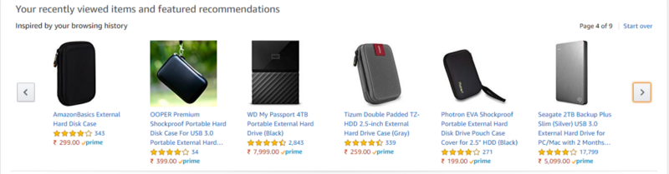
Product Similarity (Item-Item Filtering)
Product similarity is the most useful system for suggesting products based on how much the user would like the product.
If the user is browsing or searching for a particular product, they can be shown similar products.
Users often expect to find products they want quickly and move on if they have a hard time finding the relevant product.
When the user clicks on one product we can show another similar product, or if the user buys the product we can email the user advertisements or coupons based on a similar product.
Product similarity is particularly useful when we don’t know much about the user yet, but we do know what products they're viewing.

Slide 9
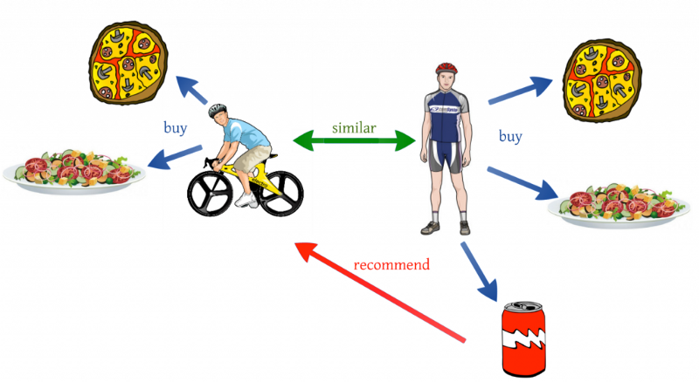
User Similarity (User-User Filtering)
User similarity is for checking the difference between the similarity of two users.
If two users have similar preferences for a product we can assume they have similar interests.
It’s like a friend recommending a product.

Slide 10
One shortcoming of user similarity, however, is that it requires all the user data to suggest products.
It’s called a cold start problem because beginning the recommendation process requires previous data from users.
A newly launched e-commerce website, for example, suffers from the cold start problem because it doesn't have a large number of users.
Product similarity doesn’t have this problem because it just requires product information and the user’s preference.
Netflix, for example, avoids this issue by asking users their likes when starting a new subscription.

Slide 11
Similarity Measures
Similarity is measured using the distance metric.
Nearest points are the most similar and farthest points are the least relevant.
The similarity is subjective and is highly dependent on the domain and application.
For example, two movies are similar because of genre or length or cast.
Care should be taken when calculating distance across dimensions/features that are unrelated.
The relative values of each element must be normalized, or one feature could end up dominating the distance calculation.

Slide 12

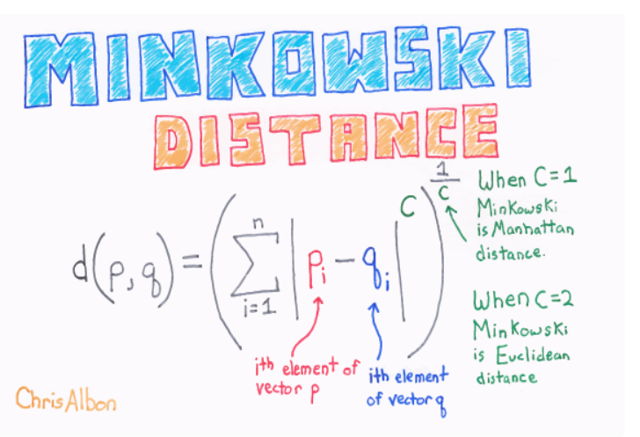
Minkowski Distance
When the dimension of a data point is numeric, the general form is called the Minkowski distance.
It is a generic distance metric where Manhattan(r=1) or Euclidean(r=2) distance measures are generalizations of it.

Slide 13
Minkowski distance is a distance measured between two points in N-dimensional space. It is basically a generalization of the Euclidean distance and the Manhattan distance. It is widely used in the field of Machine learning, especially in the concept to find the optimal correlation or classification of data.

Slide 14
Let us consider a 2-dimensional space having three points P₁ (X₁, Y₁), P₂ (X₂, Y₂), and P₃ (X_{3,} Y₃)
The Minkowski distance is given by ( |X₁ – Y₁|^{p} + |X₂ – Y₂|^{p} + |X₂ – Y₂|^{p} )^{1/p}
we are given two vectors, vect1 as (4, 2, 6, 8) and vect2 as (5, 1, 7, 9). Their Minkowski distance for p = 2 is given by, ( |4 – 5|² + |2 – 1|² + |6 – 7|² + |8 – 9|² )^{1/2} which is equal to 2.

Slide 15

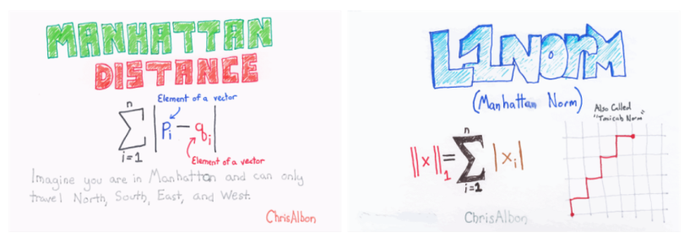
Manhattan Distance
The distance between two points measured along axes at right angles.
It is also called rectilinear distance, L1-distance/L1-norm,
Minkowski’s L1- distance, city block distance and taxi cab distance.

Slide 16

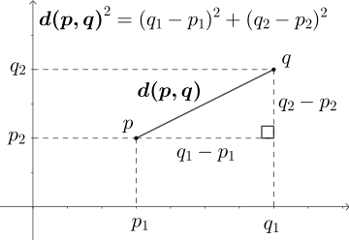
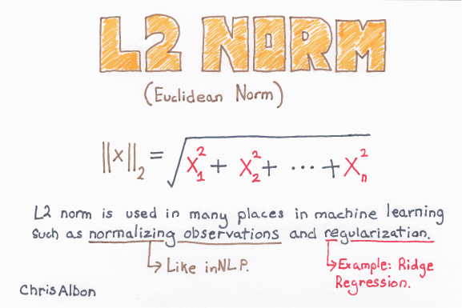
Euclidean Distance
The square root of the sum of squares of the difference between the coordinates and is given by Pythagorean theorem.

Slide 17
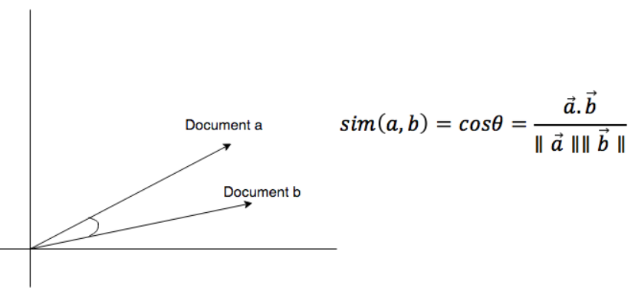
Cosine Similarity
Measures the cosine of the angle between two vectors.
It is a judgment of orientation rather than magnitude between two vectors with respect to the origin.
The cosine of 0 degrees is 1 which means the data points are similar and the cosine of 90 degrees is 0 which means data points are dissimilar.
Cosine similarity is subjective to the domain and application and is not an actual distance metric.

Slide 18
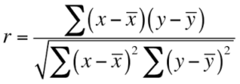
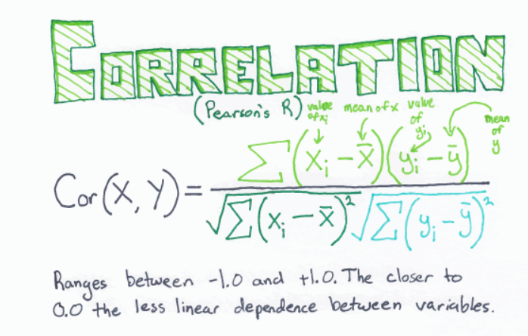
Pearson Coefficient
It is a measure of correlation between two random variables and ranges between [-1, 1].

Slide 19
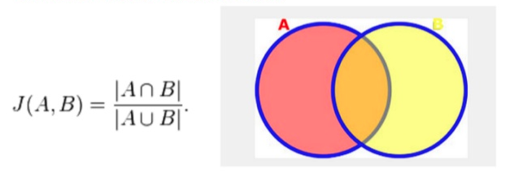
Jaccard Similarity
In the other similarity metrics, we discussed some ways to find the similarity between objects, where the objects are points or vectors.
We use Jaccard similarity to find similarities between finite sets.
It is defined as the cardinality of the intersection of sets divided by the cardinality of the union of the sample sets.

Slide 20
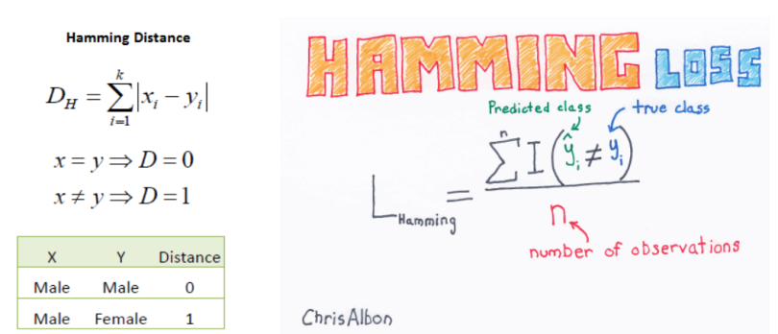
Hamming Distance
ll the similarities we discussed were distance measures for continuous variables.
In the case of categorical variables, Hamming distance must be used.

Slide 21
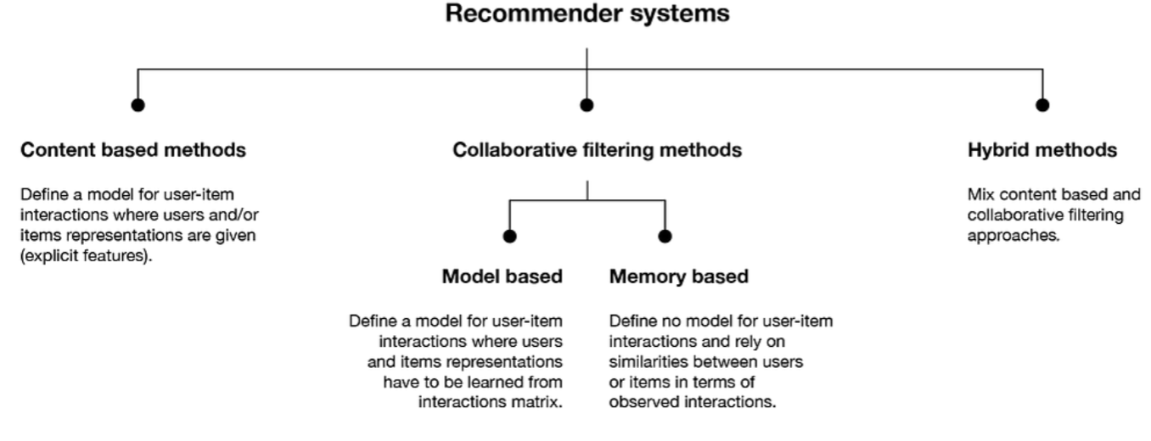
Types of Recommender Systems

Slide 22
Content-Based Recommender Systems
Content-based recommendation systems use their knowledge about each product to recommend new ones.
Recommendations are based on attributes of the item.
Content-based recommender systems work well when descriptive data on the content is provided beforehand.
“Similarity” is measured against product attributes.
Suppose I watch a movie in a particular genre, then I will be recommended movies within that specific genre.
The movie's attributes, like title, year of release, director and cast, are also helpful in identifying similar movie content.

Slide 23
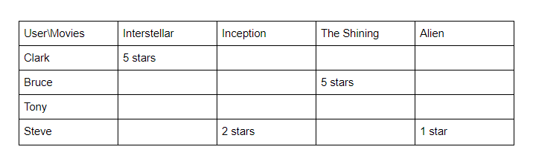
APPROACH 1: USING RATED CONTENT TO RECOMMEND
In this approach contents of the product are already rated and based on the user’s preference, then a rating is predicted for a similar product.
We'll use movie recommendations as an example.
User Ratings
In the example above, Clark and Bruce have given five-star ratings to the movies Interstellar and The Shining, clearly indicating a preference for these films.
For Tony, who has rated nothing, and Steve who has provided only low ratings, it's more difficult to discern their preferences.

Slide 24
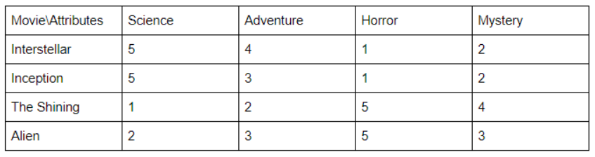
Movie Attributes
In the table above, note that Interstellar and Inception received 5s in the science category, whereas The Shining and Alien get the highest marks under the horror genre

Slide 25
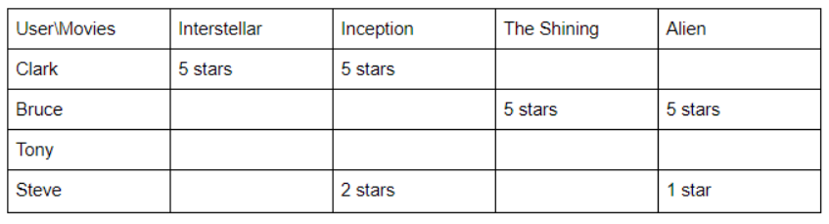
Predicted User Rating
Inception is suggested for Clark because he liked Interstellar and the movies share similar attributes.
Alien is suggested to Bruce because he liked The Shining, which is in the horror genre.
Advantages: Works even when a product has no user reviews.
Disadvantages: Requires descriptive data of all content to recommend, which is time consuming. It's also difficult to implement on large product databases as user’s have different opinions about each item.

Slide 26
APPROACH 2: RECOMMENDATION THROUGH DESCRIPTION OF THE CONTENT
This approach uses the description of the item to make recommendations.
The description goes deeper into the product details, like title, summary, tag lines, genre, etc., and it provides much more information about the item.
The format of these details are in text format(string) and it's important to convert this into numbers to easily calculate for similarity.

Slide 27

Term Frequency-Inverse Document Frequency (TF-IDF)
TF-IDF is used in information retrieval for feature extraction purposes and it is a sub-area of natural language processing (NLP).
Term Frequency: Frequency of the word in the current document to the total number of words in the document.
It signifies the occurrence of the word in a document and gives higher weight when the frequency is more, so it is divided by document length to normalize.
Inverse Document Frequency: Total number of documents to the frequency occurrence of documents containing the word.
It signifies the rarity of the word — the less the word occurs in the document, the IDF increases.
It helps in giving a higher score to rare terms in the documents.

Slide 28
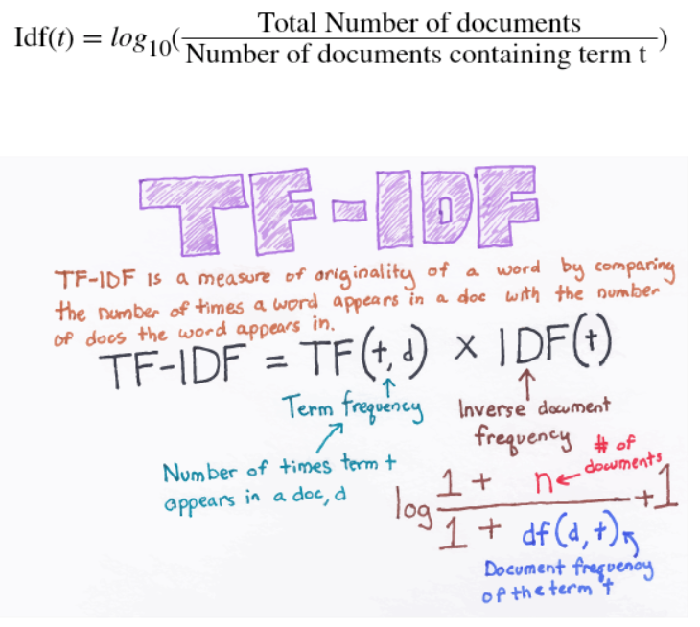

Slide 29
In the end, TF-IDF is a measure used to evaluate how important a word is to a document in a document corpus.
The importance of the word increases proportionally to the number of times a word appears in the document but is offset by the frequency of the word in the corpus.
Example for TF-IDF: Consider a document containing 100 words wherein the word "courage" appears three times. The term frequency for courage is then (3 / 100) = 0.03. Now, assume we have 10 lakh documents and the word "courage" appears in 1,000 of these. The inverse document frequency is calculated as log(10,00,000 / 1,000) = 3. Thus, the TF-IDF weight for courage is 0.03 * 3= 0.09.

Slide 30
Binary Labels in Recommender System
Binary labels in a recommender system refer to the binary, or two-valued, feedback or interactions provided by users regarding items.
In recommender systems, binary labels like "favs," "likes," and "clicks" are often used to capture user preferences or interactions with items.
These labels are used to understand and predict user behavior and preferences for recommending items to users.
Binary labels serve as signals or feedback data used by recommendation algorithms to understand user preferences.
They help in building recommendation models by predicting or inferring user preferences for items.
Algorithms can utilize these signals to create models that predict which items a user might prefer based on their history of marking items as favorites, liking items, or clicking on them.

Slide 31
Favorites (Favs)
"Favs" typically represent items that users explicitly mark or save as their favorites.
This action implies a higher level of preference or special interest in the item.
Users might designate certain items (movies, products, songs, etc.) as favorites, indicating a strong positive affinity towards those particular items.

Slide 32
Likes
"Likes" usually signify a positive interaction or approval of an item, but not necessarily as strong as marking it as a favorite.
Users might click a "like" button or perform an action indicating they have a positive sentiment or preference for the item.

Slide 33
Clicks
"Clicks" refer to the user interactions such as clicking on an item, visiting a page, or opening a link.
In recommender systems, clicks can be used as implicit feedback indicating user interest in an item, although it might not explicitly imply preference or satisfaction.

Slide 34
Example
Suppose we have a user-item interaction matrix where users provide binary feedback for items.
User-Item Interaction Matrix:
Item1|Item2|Item3|Item 4
User 1 1 | 0 | 1 | 0
User 2 0 | 1 | 1 | 0
User 3 1 | 0 | 0 | 1
Users are represented by rows (User 1, User 2, User 3).
Items are represented by columns (Item 1, Item 2, Item 3, Item 4).
Each cell in the matrix contains a binary label (1 or 0), indicating user interaction with an item. For instance:
'1' represents a positive interaction (like, click, purchase, etc.).
'0' represents no interaction or a lack of interest.
Interpretation:
User 1 interacted with Item 1 and Item 3 but did not interact with Item 2 or Item 4.
User 2 interacted with Item 2 and Item 3 but not with Item 1 or Item 4.
User 3 interacted with Item 1 and Item 4 but did not interact with Item 2 or Item 3.
These binary labels could represent various interactions:
User liking or favoriting an item (indicated by '1').
Lack of interest or no interaction with an item (indicated by ‘0’).

Slide 35
Mean Normalization
Mean normalization is a technique used in recommender systems and various data analysis contexts to preprocess data, specifically to normalize and scale the values within a certain range.
It involves adjusting values in a dataset by subtracting the mean and dividing by the range or standard deviation.
In the context of recommender systems, mean normalization might be applied to user-item interaction data in a user-item matrix.

Slide 36
Significance of Mean Normalization
Standardize the data and bring it to a common scale.
Make data centered around zero, which helps algorithms converge faster and prevents bias in models.
Reduce the impact of different users having varied rating scales (some users might tend to rate higher than others).

Slide 37
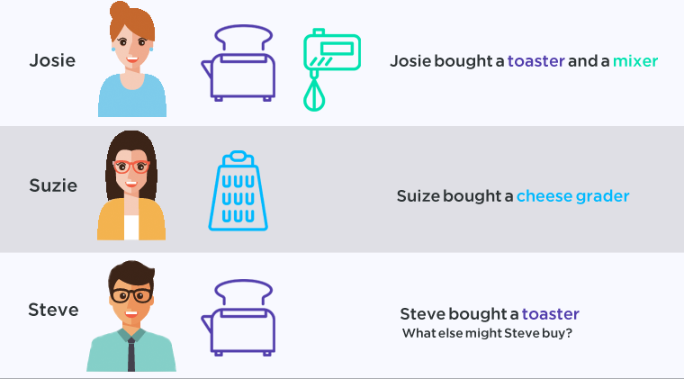
Collaborative Filtering Recommender Systems
Collaborative filtering recommenders make suggestions based on how users rated in the past and not based on the product themselves.
It only knows how other customers rated the product. “Similarity” is measured against the similarity of users.

Slide 38
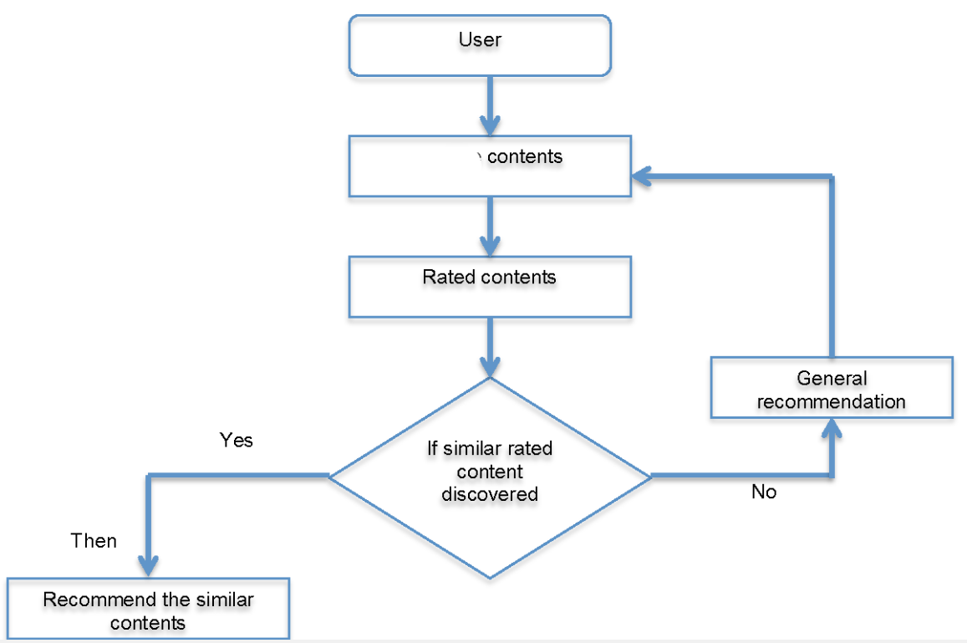

Slide 39
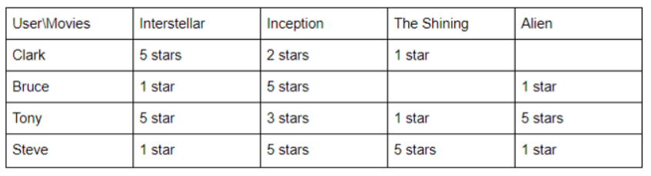
USER RATING
As we can see from above Clark and Tony have similar tastes as they rated movies similarly.

Slide 40
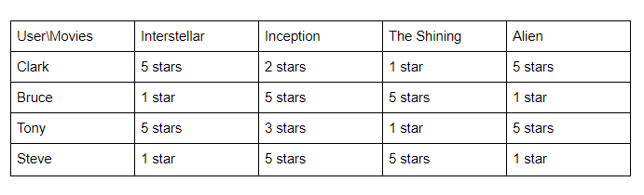
PREDICTED USER RATING
Clark is recommended "Alien" from Tony because of their similarity in rating.
Bruce was suggested "The Shining" because Steve rated it highly.
Advantages:
No requirement for product descriptions.

Slide 41
Disadvantages:
Can’t recommend items if no user reviews exist (suffers from the cold start problem).
Difficult to recommend new users and is inclined to favor popular products with lots of reviews.
Suffers from a sparsity problem(values that will not significantly impact) as the user will review only selected items.
Faces the "gray sheep problem" (i.e., useful predictions cannot be made due to sparsity).
Difficult to recommend new releases since they have less reviews.

Slide 42
What is the GREY sheep problem in collaborative filtering?
"Grey Sheep" users is a group of the users who have special tastes and they may neither agree nor disagree with the majority of the users. The identification of them becomes a challenge in collaborative filtering, since they may introduce difficulties to produce accurate collaborative recommendations.

Slide 43
Memory Based Recommender System
Memory-based recommender systems, also known as neighborhood-based recommender systems, rely on the idea of finding similar users or items to generate recommendations.
These systems make predictions based on the preferences or interactions of users or items without employing any complex mathematical models.
There are two main types of memory-based recommender systems:
User-Based Collaborative Filtering
Item-Based Collaborative Filtering

Slide 44
User-Based Collaborative Filtering
User-Based Collaborative Filtering (UBCF) is a popular approach in recommender systems where recommendations are generated based on the behaviors and preferences of similar users.
The basic idea is to find users who are similar to the target user and recommend items liked or rated highly by those similar users.
UBCF relies on the assumption that users who have similar preferences in the past will have similar preferences in the future.

Slide 45
Here's a step-by-step explanation of how to implement a simple User-Based Collaborative Filtering recommendation system:
User-Item Interaction Matrix:
Represent the user-item interactions in a matrix where rows represent users, columns represent items, and the values represent user interactions (e.g., ratings, likes, purchase history).
Similarity Calculation:
Compute similarity between users based on their interactions using a similarity metric such as cosine similarity or Pearson correlation.
Identify Similar Users:
Identify the most similar users to the target user based on the computed similarity scores.
Generate Recommendations:
Recommend items that the target user has not interacted with, based on the interactions of similar users. Sort the recommended items by their predicted ratings or interactions.
Present Recommendations:
Present the top-N recommended items to the target user.

Slide 46
Item based collaborative filtering
Item-Based Collaborative Filtering (IBCF) is a popular technique used in recommender systems to provide recommendations based on similarities between items rather than users.
It recommends items to a user based on their interactions with similar items.
The core idea is that if a user likes or interacts with a certain item, they are likely to like other items that are similar to it.

Slide 47
Model Based Collaborative Filtering
Model-Based Collaborative Filtering is an approach used in recommender systems that involves building predictive models based on the user-item interaction data to make recommendations.
These models use machine learning or matrix factorization techniques to learn patterns, preferences, and relationships from the data to generate personalized recommendations.

Slide 48
Here's an overview of the steps to implement Model-Based Collaborative Filtering:
User-Item Interaction Matrix:
Create a matrix where rows represent users, columns represent items, and the values represent user interactions (e.g., ratings, likes, purchase history).
Model Training:
Train a machine learning model (e.g., matrix factorization, neural networks) on the interaction data to learn the underlying patterns and preferences.
Model Evaluation:
Evaluate the model's performance using appropriate evaluation metrics (e.g., mean squared error, accuracy, etc.).
Generate Recommendations:
Use the trained model to generate recommendations for each user based on their interactions and predicted preferences.
Present Recommendations:
Present the top-N recommended items to the users.

Slide 49
Matrix factorization methods like Singular Value Decomposition (SVD), Alternating Least Squares (ALS), and deep learning-based approaches like neural collaborative filtering (NCF) are commonly used in model-based collaborative filtering.

Slide 50
Hybrid recommendation system
A hybrid recommendation system is a type of recommendation system that combines two or more recommendation approaches or techniques to provide more accurate and personalized recommendations to users. These hybrid systems leverage the strengths of different recommendation methods to overcome the limitations of individual approaches.

Slide 51
You must have heard of Collaborative filtering and Content-based filtering before:
Collaborative filtering analyzes user-item interactions and identifies similarities between users or items to make recommendations. It recommends items users with similar preferences have liked or consumed. However, it may struggle with new or niche items having limited user interactions.
On the other hand, content-based filtering focuses on features and characteristics of items to recommend similar items to users based on their preferences. It examines attributes like product descriptions, brands, categories, and user profiles. However, it may not capture the complexity of user preferences and may result in less diverse recommendations.

Slide 52
This is where a hybrid recommendation system helps.
By combining collaborative and content-based filtering in a hybrid system, we can overcome the limitations of collaborative and content-based filtering.
The collaborative filtering component captures the wisdom of the crowd, while the content-based filtering component takes into account the specific features and attributes of items.
This combination allows the system to provide more accurate recommendations, especially in situations where user-item interactions are rare or when personalized recommendations are desired.

Slide 53
Examples of Recommender System
AMAZON
IMDB
FACEBOOK & INSTAGRAM
YOUTUBE
GOOGLE
ANOTHER GOOGLE SUBSIDIARY- GMAIL

Slide 54
Ethical Use of Recommender System
The ethical use of recommender systems is of paramount importance to ensure that users are provided with fair, transparent, and helpful recommendations while respecting their privacy and well-being.
Transparency and Explanation:
Provide clear explanations of how the recommender system works, what data is used, and how recommendations are generated. Users should understand why certain recommendations are being made.
User Control and Customization:
Allow users to have control over the recommendations they receive. Offer options for customization, preferences, and the ability to filter or adjust recommendations according to their needs and preferences.
Avoid Discrimination and Bias:
Strive to eliminate biases related to race, gender, age, ethnicity, or any other characteristic. Ensure that the recommender system provides fair and unbiased recommendations to all users.
Diversity and Serendipity:
Aim to offer a diverse set of recommendations, avoiding filter bubbles where users are only exposed to content similar to their previous choices. Encourage users to explore a variety of content.

Slide 55
Informed Consent and Privacy:
Obtain informed consent from users regarding data collection, usage, and sharing. Clearly explain the privacy policy and how user data is handled, stored, and protected.
Data Collection and Storage:
Collect and store only the necessary data for providing recommendations. Implement strong security measures to protect user data from unauthorized access or misuse.
Prevent Over-Personalization:
Avoid excessive personalization that may lead to a "creepy" feeling for users. Strive for a balance between personalization and maintaining user privacy.
Avoid Manipulation and Exploitation:
Do not manipulate users or exploit their vulnerabilities to increase engagement or interactions. Prioritize the user's best interests and well-being.

Slide 56
Feedback Mechanism:
Implement a feedback mechanism where users can report issues, biases, or concerns related to recommendations. Use this feedback to improve the recommender system.
Regular Audits and Assessments:
Conduct regular audits and assessments of the recommender system to ensure compliance with ethical guidelines and standards. Address any identified issues promptly.
Stakeholder Involvement:
Involve relevant stakeholders, including users, domain experts, ethicists, and diverse communities, in the design, development, and evaluation of the recommender system to incorporate different perspectives.
Education and Awareness:
Educate users about how recommender systems function and their ethical implications. Promote digital literacy and awareness regarding online content and recommendations.

Slide 57
Thanks

